Slide 1
Fire Fighting Hexapod Robot Using Inertia Measurement Unit (IMU) With Smartphone
By :
Adhitya Wicaksono
Mifta Adiwira
Nicholas J Nainggolan

Slide 2
Background

Slide 3
The current technological developments have increased so rapidly to various sides of human life. The development is supported by the availability of hardware (hardware) and software (software) are becoming more sophisticated and increased capabilities. A blend of hardware and software can make a sophisticated system which is certainly great savings in terms of manufacturing costs and maintenance costs. In case of damage, such damage not only from the hardware but can be derived from the software.

Slide 4
The system can be improved through software by deleting and fill with new software without having to spend more. The emergence of sensors increasingly sophisticated world of electronics is now able to support a human to create software. Humans are expected to create software that can be used to support hardware-hardware to be a highly sophisticated system and would be very useful to facilitate human work

Slide 5
This is enabled so that the robot can walk to extinguish the fire in accordance with the group we expected.

Slide 6
Problems

Slide 7
Robot tasked to find and extinguish the flames that are surrounding.
Smart Robot Fire is one form of mobile robot is designed to be able to take action to search for the source of fire and extinguish the candle mark it by dropping a beeper (sound-producing modules) in an arena that has been determined. To allow robots to navigate arena properly, it must be applied right algorithm. So the robot was designed / constructed from several components that determine the performance of the robot itself. The components of these are to be considered / taken into account in the design problem, which will be described below.
Design and manufacture of intelligent fire extinguisher robot which includes hardware design (hardware) and software design (software). In the design of the hardware (hardware) includes the manufacture of mechanical robot and designing the framework of an electronic circuit that is used in its entirety. Order mechanical robot consists of acrylic material and electronic circuit consisting of a series STM32F4 Discovery microcontroller, direct current motor control circuit, a series of ultrasonic sensors (transmitter and receiver), and a series of fire detection sensors. While the design of software (software) includes the design on the manufacturing flow diagrams and assembly language.

Slide 8
PURPOSE

Slide 9
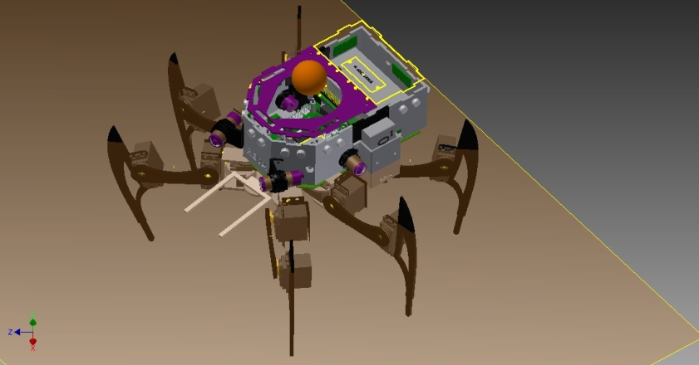
Robot Design

Slide 10
The purpose of this robot is to plan, design and create an intelligent robotic system that can search for the source of the fire and extinguish it. Another advantage of this robot can choose a larger fires by knowing the temperature should be higher than the venue.

Slide 11
The Benefits

Slide 12
Increase worker safety by preventing accidents since humans are not performing risky jobs.
User are able to move robot and extinguish the fire with just one single touch (inverse kinematic algorithm)
Easy to use, hi-tech for a technology enthusiast
Strong and solid product made from certain material such as iron,plastic and sillicon rubber
User are able to find exact location of the fire. With TPA-81 (sensor) It can detect fire and tell the robot to extinguish the fire
Gyroscope accelerometer can sense rotation, more flexibel more fun too.

Slide 13
Market target

Slide 14
The market targets of this project are listed below:
A target market is a group of customers a business has decided to aim its marketing efforts and ultimately its merchandise towards.
Target Market
Household
Military
Robotic enthusiasm
Software developer
Executive/Rich people

Slide 15
Technical Preparations

Slide 16
Gyroscope accelerometer
Sensor
UV Tron Sensor (detect UV-light from fire)
Sensor Proximity (detect object)
Sonar Sensor (detect distance)
Fire sensor (detects presence of fire)
Main Controller using
PWM generator; Interrupt system for response
Timer for accurate timing
mikrokontroller STM32F4 Discovery
Built-in-ADC (Analog-to-Digital Converter)
Motor Controller using
18 servo for precise control and 1 servo for fan control
Motion Controller using
Board SSC32(serial servo controller 32 Channel)

Slide 17
How it work and risk analysis

Slide 18
Way to work
The software is used to operate the fire fighting spider robot. It will make the robot to move, search the fire, and also extinguish the fire.
The robot move using inverse kinematics algorithm so it can walk more precision. The robot is moved by motor servo on it’s feet.
Each legs contains 3 motor servo and namely coxa, femur, and tibia.
The robot have 6 legs, so it needs 18 motor servo to move.
With inverse kinematics algorithm, all the servos can be moved more efficient and precisions.

Slide 19
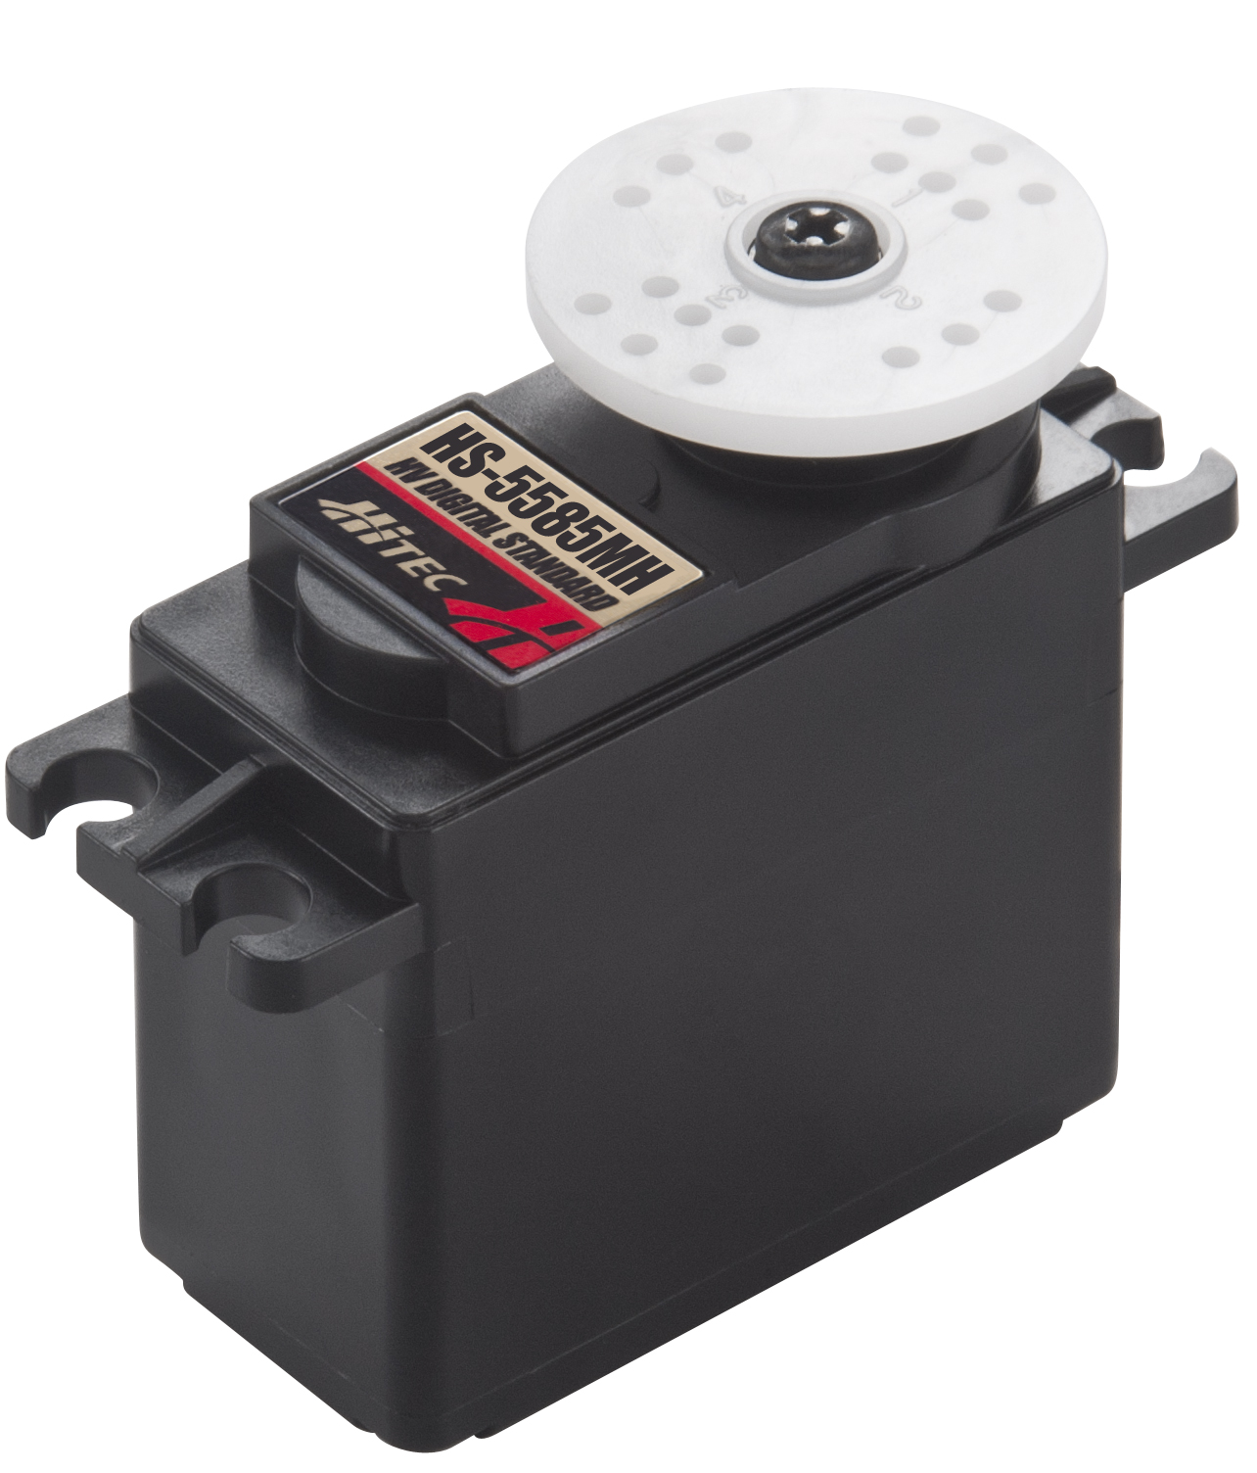
Motor Servo as Actuator
Motor Servo as actuator. Each legs have 3 motor servo.
The robot move with legs by moving motor servo.

Slide 20
Way to work cont…
The robot have several sensors to detect and find the fire.
UV TRON is a sensor that used to detect ultra-violet light that made by fire. How far the fire is determined by how many external interrupt occurs.

Slide 21
UV-TRON Sensor
Bulb to detect the UV-Light
that was produced by fire
Driver to process bulb read and
produce external interrupt to
microcontroller

Slide 22
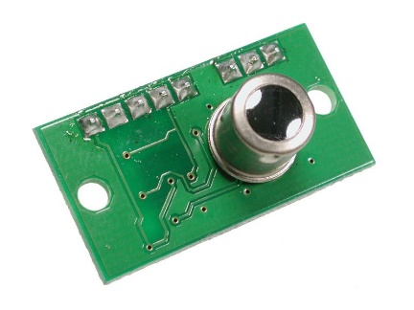
TPA-81 Flame Sensor
TPA-81 Flame Sensor to detect fire location

Slide 23
Risk analysis
Failure on communication between smartphones and firefighting spider robot. Missing communication between gadget and robot may be occur and can make a serious impact. The robot will lost control and may go to fire then get burn.
Failure on communication may be due by interference from another wave. It can solve by using more than one communication devices so when one communication protocol not work properly, there is still another communication protocol that the device and robot can use.

Slide 24
Risk analysis cont…
Electronic devices may be harm due to high temperature. There are possibilities that some electronic component may be broken or can’t work properly caused high temperature. This condition may be impact the robot to stop to operate. At the end, the robot may be burned by the fire around it.

Slide 25
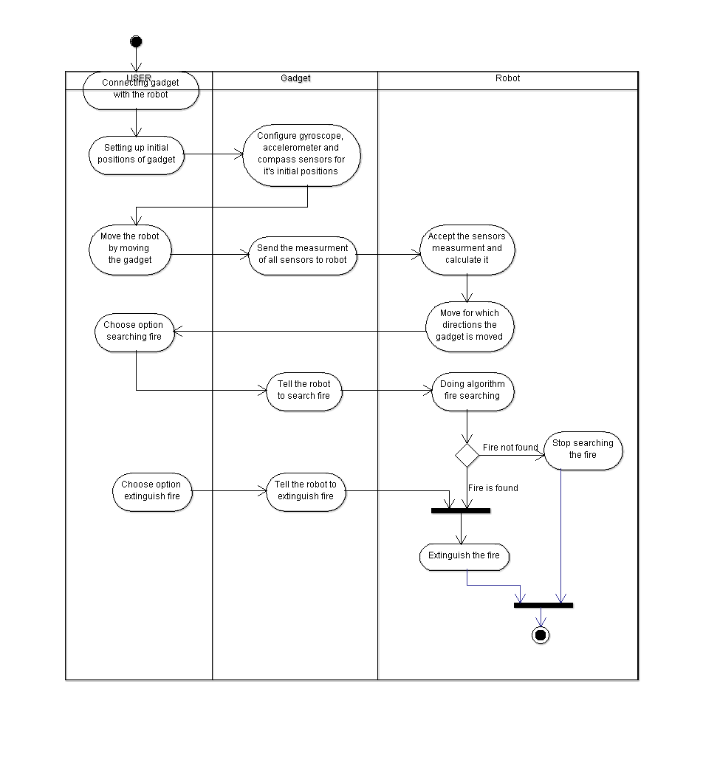
Activity Diagram

Slide 26
Activity Diagram Explanation
First, we have to connect from the gadget to the robot. after connecting we must set the initial position of our gadgets. after setting, we have to configure the gyroscope, accelerometer and compass sensors for menginisialkan position. after that, we can move the robot out of our gadgets. after the robot can move, we will take measurements from the sensors to the robot. after getting the sensor robot, the robot will be counted. after that, we may be able to move to wherever we want to. then after that, we could do a test sensor to the robot with fire. then, move the robot to find the hotspots. then, the robot will perform a search. if not met, then the robot will stop searching for the point of the fire. if met, then we will do the command to turn off the fire. then the fire will be extinguished.

Slide 27
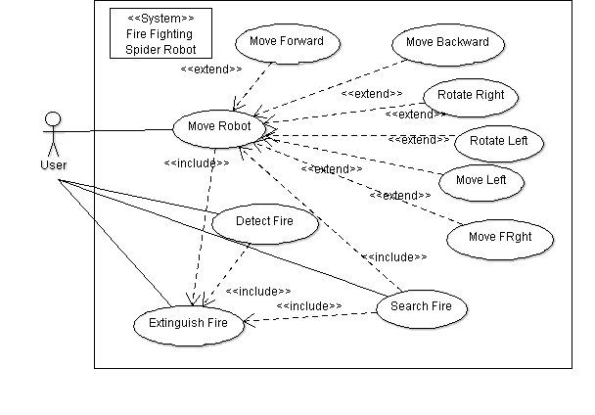
Use Case Diagram

Slide 28
Use Case Diagram Explanation
The fire fighter hexapod robot has several features that the user can used. The user can control the robot to move through the application.
The application use gyroscope, accelerometer, and compass sensor that implemented in smartphone to measure the movement.
Move robot have several movements, those are move forward, move backward, move left, move right, rotate left, rotate right. These movements are inherited from move robot.
Other operations that the user can do are extinguish fire, detect fire, and search fire.
Move robot, detect fire, and search fire are inherited from extinguish fire. Since extinguish fire is the main aim from this robot, so any operations must be to doing this task.
If the robot detect the fire, then it will extinguish the fire. Search fire also is done in order to extinguish the fire. These operations are doing by moving the robot and use any sensors to detect the fire.

Slide 29
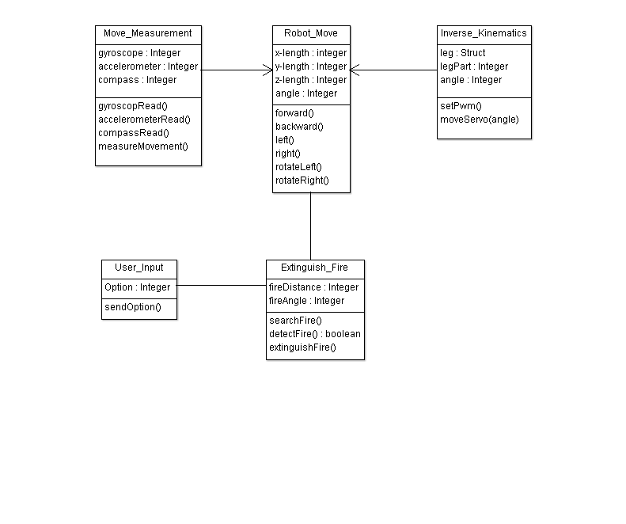
Class Diagram

Slide 30
Class Diagram Explanation
Robot_Move cannot stand alone without class/table move_measurement and inverse_Kinematics because it cant runs well
Move_measurement to robot_move and inverse_kinemetic to robot_move is many to many
1 User input may include many move

Slide 31
Implementation

Slide 32
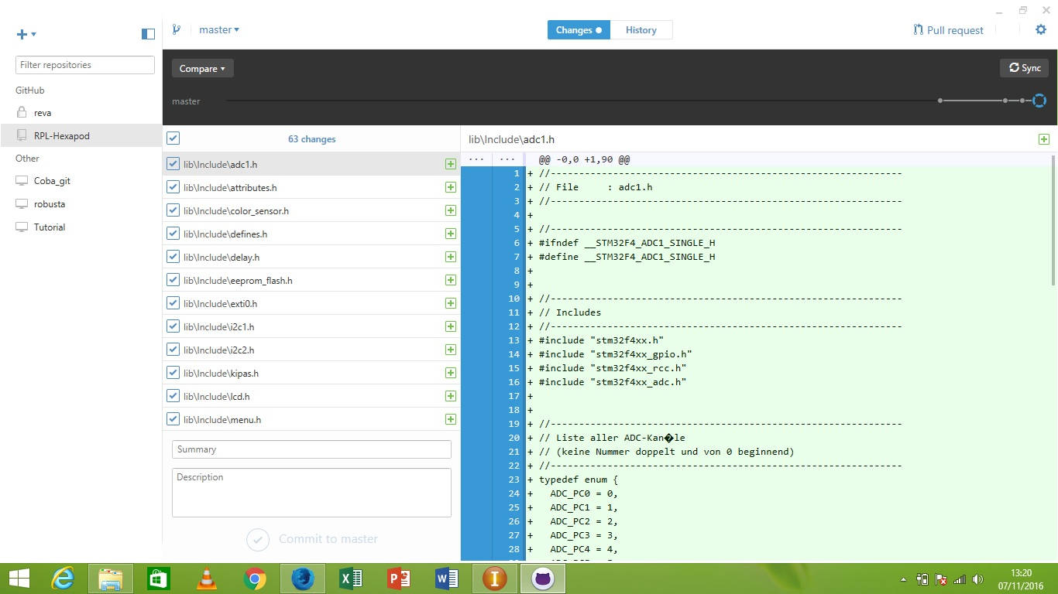
Creating New Repository on Github

Slide 33
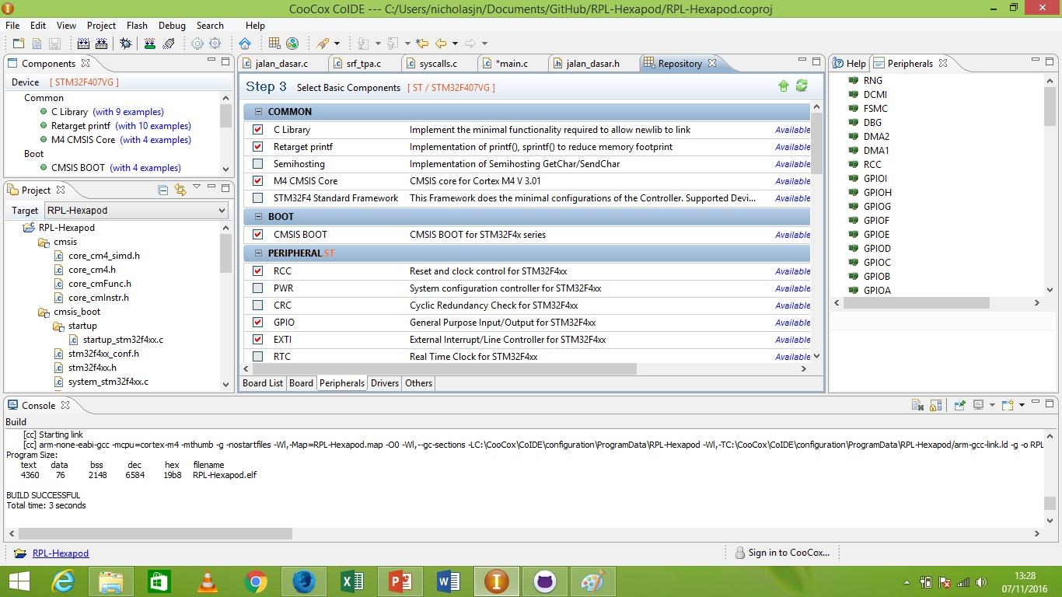
Making New Project in CooCox CoIDE

Slide 34
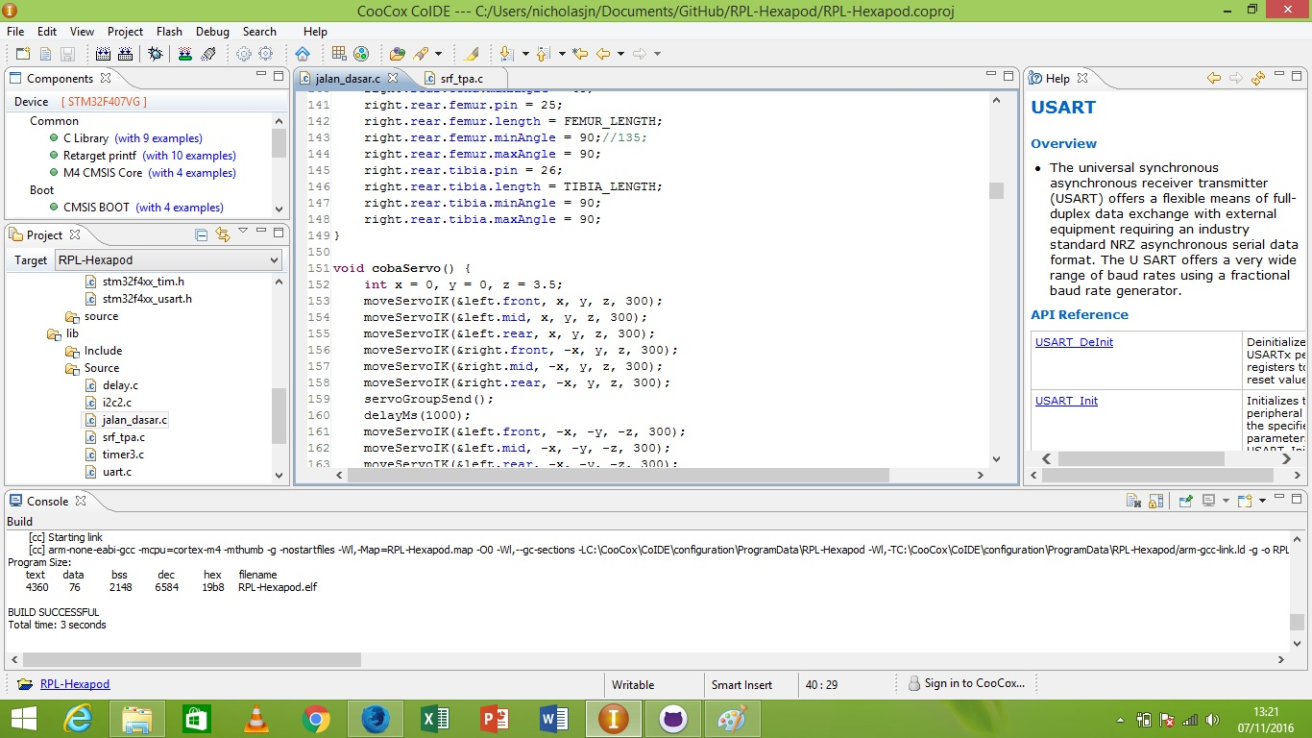
Program Inverse Kinematics

Slide 35
